Slide 1

Retrieve Data from Multiple Tables

Slide 2

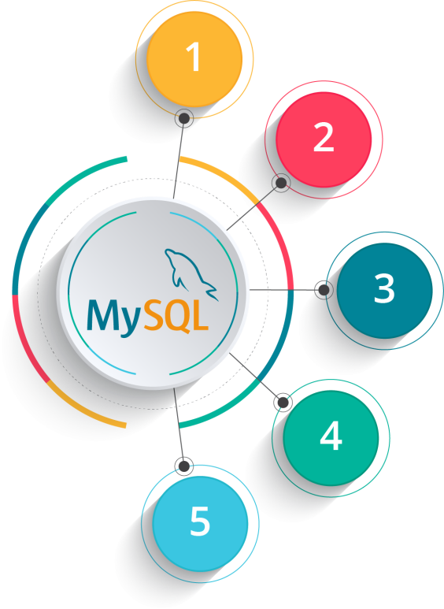



Course Outline
DDL (Data Definitions Language) Commands
DML (Data Manipulation Language) Commands
Retrieve Data from Multiple Tables
Inbuilt Functions in SQL
Create Advance Database Objects
Copyright © 2017, edureka and/or its affiliates. All rights reserved.

Slide 3


Retrieve Data from Multiple Tables
Copyright © 2017, edureka and/or its affiliates. All rights reserved.

Slide 4

Objectives
After completing this module, you should be able to:
▪
Perceive and use the following important types of joins in SQL-
•
Inner Join
•
Left Join
•
Right Join
•
Cross Join

Slide 5
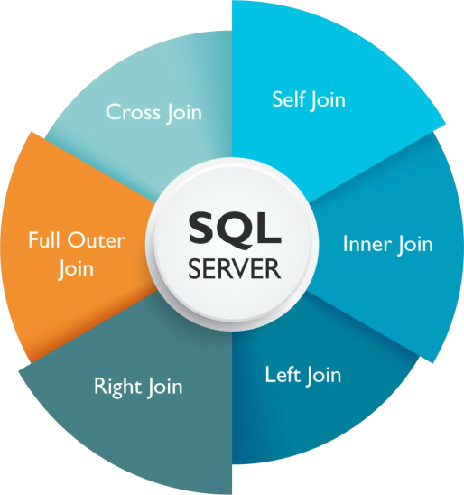
SQL Joins
▪
A Join clause is used to fetch data from two or more data tables, based on join condition
▪
Join clause is used to combine rows from one (Self-Join) or more tables, based on a related column(s)
between them
▪
In SQL server we have:

Slide 6
Self-Join
A table can be joined to itself in a Self-Join
Syntax:
SELECT <column_list>
FROM <table_name1> t1
JOIN <table_name1> t2
ON t1.column_name = t2.column_name;

Slide 7
Self Join: Example
Example:
Output:
Employee
Manager
SELECT
t2.first_name as Employee
,t1.first_name as Manager
FROM
employee t1 JOIN employee t2
ON t1.emp_id = t2.mgr_id;
Scott
Allen
Martin
Allen
Arthur
Jake
Quincy
Allen
Smith
Quincy
Miller
Allen

Slide 8
Inner Join
The INNER join fetches records that have matching values in both tables
Syntax:
SELECT <column_list>
FROM <table_name1> as t1
INNER JOIN <table_name2> as t2
ON t1.column_name = t2.column_name;

Slide 9
Inner Join: Example
Example:
Output:
Select
t2.first_name, as FirstName
,t1.dept_name as Department
From
dept t1
INNER JOIN employee t2
ON t1.deptno = t2.deptno;
FirstName
Department
Allen
Accounts
Scott
Accounts
Martin
Accounts
Jake
HR
Arthur
HR
Quincy
IT
Smith
IT

Slide 10
LEFT OUTER Join
▪
The LEFT OUTER Join returns rows to the left (t1) even if there are no rows on the right (t2) of the join
clause
▪
The result is NULL for rows on RIGTH table, when there is no match
Syntax:
SELECT <column_list>
FROM <table_name1> as t1
LEFT OUTER JOIN <table_name2> as t2
ON t1.column_name = t2.column_name;

Slide 11
LEFT OUTER Join: Example
Output:
Example:
FirstName
Department
Select
t1.first_name as FirstName
,t2.dept_name as Department
From
employee t1
LEFT OUTER JOIN dept t2
ON t1.deptno = t2.deptno;
Allen
Accounts
Scott
Accounts
Martin
Accounts
Jake
HR
Arthur
HR
Quincy
IT
Smith
IT
Miller
NULL

Slide 12
RIGHT OUTER Join
▪
The RIGHT OUTER join returns the rows to the right (t2) relation (table) even if there are no matching rows
on the left (t1) relation (table)
▪
The result is NULL for rows on LEFT table, when there is no match
Syntax:
SELECT <column_list>
FROM <table_name1> as t1
RIGHT OUTER JOIN <table_name2> as t2
ON t1.column_name = t2.column_name;

Slide 13
RIGHT OUTER Join: Example
Output:
Example:
FirstName
Department
Select
t1.first_name as FirstName
,t2.dept_name as Department
From
employee t1
RIGHT OUTER JOIN dept t2
ON t1.deptno = t2.deptno;
Allen
Accounts
Scott
Accounts
Martin
Accounts
Jake
HR
Arthur
HR
Quincy
IT
Smith
IT
NULL
Marketing

Slide 14
FULL OUTER Join
▪
The FULL OUTER JOIN keyword return all records when there is a match in either left (t1) or right (t2) table
records
▪
If there are rows in ”t1" that do not have matches in ”t2” or vice-versa, those rows will be listed as well
Syntax:
SELECT <column_list>
FROM <table_name1> as t1
FULL OUTER JOIN <table_name2> as t2
ON t1.column_name = t2.column_name;

Slide 15
FULL OUTER Join: Example
Output:
Example:
FirstName
Department
SELECT
t1.first_name as FirstName
,t2.dept_name as Department
FROM
employee as t1
FULL OUTER JOIN dept as t2
ON t1.deptno = t2.deptno
Allen
Accounts
Scott
Accounts
Martin
Accounts
Jake
HR
Arthur
HR
Quincy
IT
Smith
IT
Miller
NULL
NULL
Marketing

Slide 16

CROSS Join
▪
Displays all the rows and all the columns of both the tables
▪
This is also called Cartesian product
Syntax:
SELECT <column_list>
FROM <table_name1> as t1
CROSS JOIN <table_name2> as t2;

Slide 17
CROSS Join: Example
Example:
Output:
Select
t1.dept_name as Department
,t2.first_name as FirstName
From
dept t1
CROSS JOIN employee t2;
Department
FirstName
Accounts
Allen
Accounts
Scott
Accounts
Martin
Accounts
Jake
Accounts
Arthur
Accounts
Quincy
Accounts
Smith
Accounts
Miller
HR
Allen
HR
Scott
…….
HR
Miller
IT
Allen
IT
Scott
…….
Marketing
Allen
Marketing
Scott
……

Slide 18

Summary
In this module, you should have learnt:
▪
Self Join
▪
Inner Join
▪
Left Join
▪
Right Join
▪
Full Outer Join
▪
Cross Join

Slide 19


Copyright © 2017, edureka and/or its affiliates. All rights reserved.

Slide 20

Copyright © 2017, edureka and/or its affiliates. All rights reserved.

Slide 21


